Slide 1

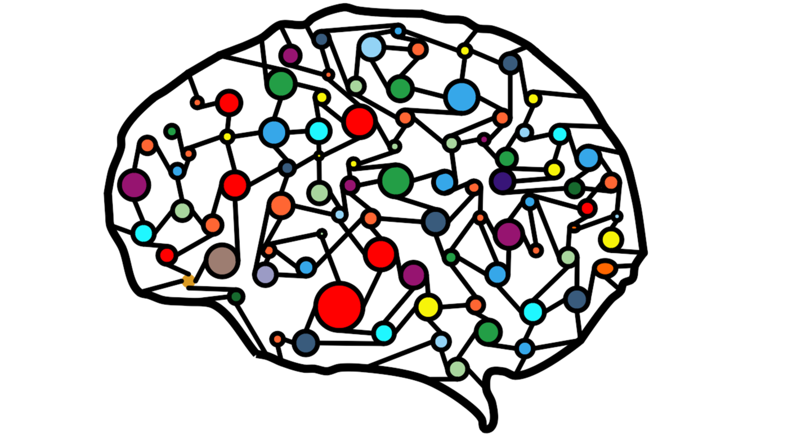
MEM437 – Yapay Sinir Ağları Dr. Ali Tahir Karaşahin
Yapay Sinir Ağları ile
MNIST Veri Seti Üzerinden Sınıflandırma Örneği

Slide 2
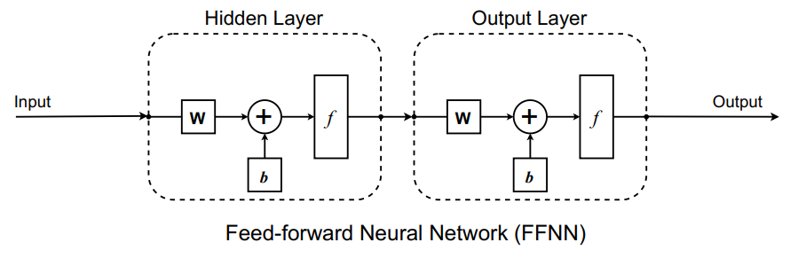
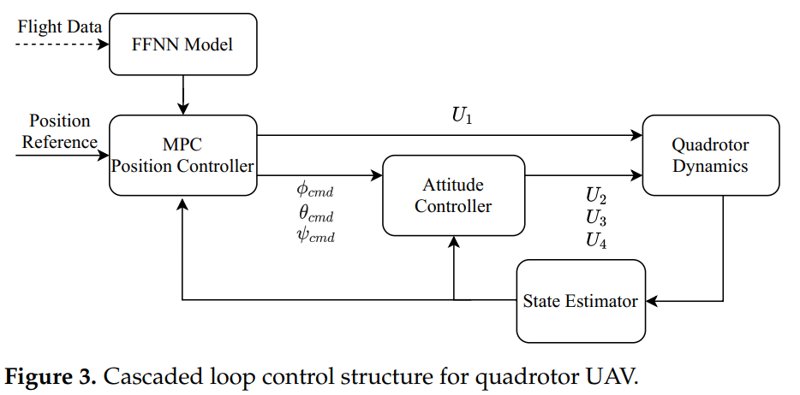
Sinir ağlarının kontrol uygulamalarında kullanılması
[46]

Slide 3
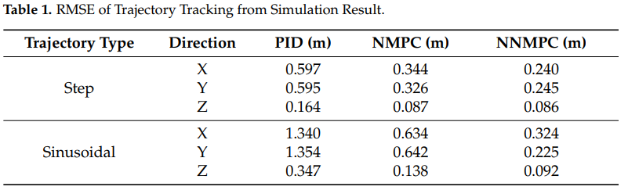
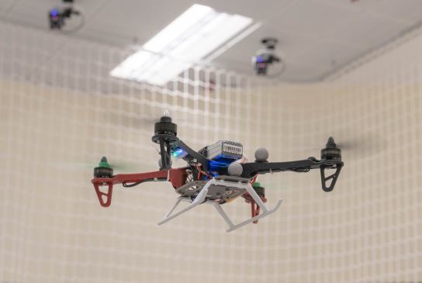
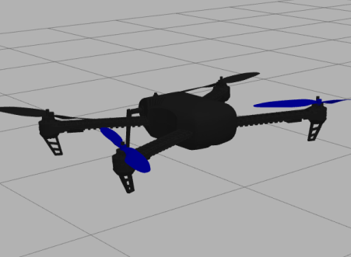
[46]

Slide 4
[47]

Slide 5
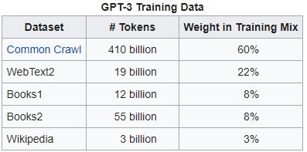
GPT-3 Eğitim Verisi
[48]

Slide 6
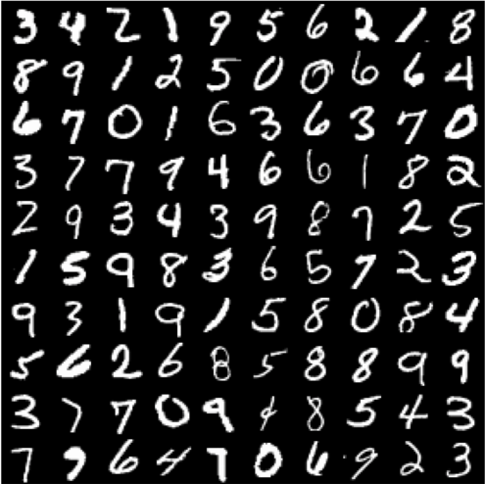
MNIST Veri Seti
28x28 gri tonlamalı piksellerden oluşmaktadır.
Veri seti büyüklüğü: 60 bindir.
Bu veri seti için tasarlanacak sinir ağının girdi katmanındaki proses eleman sayısı 784 olmalıdır.
Veri setine göre 10 farklı sınıflandırma işlemi yapılacağından çıktı katmanındaki proses eleman sayısı 10’dur.
Veri seti eğitim ve test olmak üzere ikiye ayrılmıştır.

Slide 7
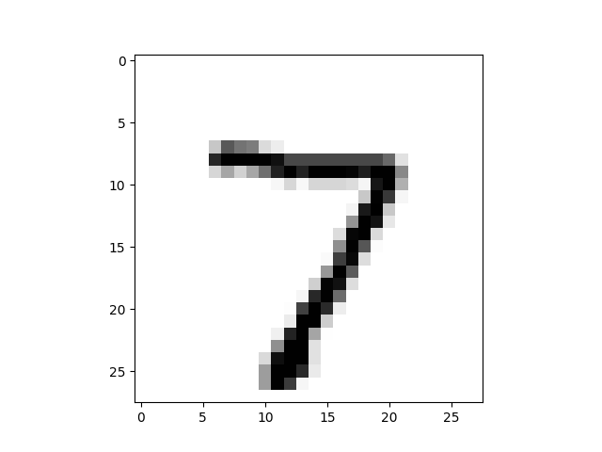
MNIST Veri Seti
7 rakamına ait veri
7,0,0,0,0,0,0,0,0,0,0,0,0,0,0,0,0,0,0,0,0,0,0,0,0,0,0,0,0,0,0,0,0,0,0,0,0,0,0,0,0,0,0,0,0,0,0,0,0,0,0,0,0,0,0,0,0,0,0,0,0,0,0,0,0,0,0,0,0,0,0,0,0,0,0,0,0,0,0,0,0,0,0,0,0,0,0,0,0,0,0,0,0,0,0,0,0,0,0,0,0,0,0,0,0,0,0,0,0,0,0,0,0,0,0,0,0,0,0,0,0,0,0,0,0,0,0,0,0,0,0,0,0,0,0,0,0,0,0,0,0,0,0,0,0,0,0,0,0,0,0,0,0,0,0,0,0,0,0,0,0,0,0,0,0,0,0,0,0,0,0,0,0,0,0,0,0,0,0,0,0,0,0,0,0,0,0,0,0,0,0,0,0,0,0,0,0,0,0,0,0,0,0,84,185,159,151,60,36,0,0,0,0,0,0,0,0,0,0,0,0,0,0,0,0,0,0,0,0,0,0,222,254,254,254,254,241,198,198,198,198,198,198,198,198,170,52,0,0,0,0,0,0,0,0,0,0,0,0,67,114,72,114,163,227,254,225,254,254,254,250,229,254,254,140,0,0,0,0,0,0,0,0,0,0,0,0,0,0,0,0,0,17,66,14,67,67,67,59,21,236,254,106,0,0,0,0,0,0,0,0,0,0,0,0,0,0,0,0,0,0,0,0,0,0,0,0,83,253,209,18,0,0,0,0,0,0,0,0,0,0,0,0,0,0,0,0,0,0,0,0,0,0,0,22,233,255,83,0,0,0,0,0,0,0,0,0,0,0,0,0,0,0,0,0,0,0,0,0,0,0,0,129,254,238,44,0,0,0,0,0,0,0,0,0,0,0,0,0,0,0,0,0,0,0,0,0,0,0,59,249,254,62,0,0,0,0,0,0,0,0,0,0,0,0,0,0,0,0,0,0,0,0,0,0,0,0,133,254,187,5,0,0,0,0,0,0,0,0,0,0,0,0,0,0,0,0,0,0,0,0,0,0,0,9,205,248,58,0,0,0,0,0,0,0,0,0,0,0,0,0,0,0,0,0,0,0,0,0,0,0,0,126,254,182,0,0,0,0,0,0,0,0,0,0,0,0,0,0,0,0,0,0,0,0,0,0,0,0,75,251,240,57,0,0,0,0,0,0,0,0,0,0,0,0,0,0,0,0,0,0,0,0,0,0,0,19,221,254,166,0,0,0,0,0,0,0,0,0,0,0,0,0,0,0,0,0,0,0,0,0,0,0,3,203,254,219,35,0,0,0,0,0,0,0,0,0,0,0,0,0,0,0,0,0,0,0,0,0,0,0,38,254,254,77,0,0,0,0,0,0,0,0,0,0,0,0,0,0,0,0,0,0,0,0,0,0,0,31,224,254,115,1,0,0,0,0,0,0,0,0,0,0,0,0,0,0,0,0,0,0,0,0,0,0,0,133,254,254,52,0,0,0,0,0,0,0,0,0,0,0,0,0,0,0,0,0,0,0,0,0,0,0,61,242,254,254,52,0,0,0,0,0,0,0,0,0,0,0,0,0,0,0,0,0,0,0,0,0,0,0,121,254,254,219,40,0,0,0,0,0,0,0,0,0,0,0,0,0,0,0,0,0,0,0,0,0,0,0,121,254,207,18,0,0,0,0,0,0,0,0,0,0,0,0,0,0,0,0,0,0,0,0,0,0,0,0,0,0,0,0,0,0,0,0,0,0,0,0,0,0,0,0,0,0

Slide 8
Python Kodu – Class oluşturulması
import matplotlib.pyplot as plt
import numpy as np
# neural network class definition
class neuralNetwork:
# initialise the neural network
def __init__(self, inputNodes, hiddenNodes, outputNodes, learningRate):
# set number of nodes in each input, hidden, output layer
self.inodes = inputNodes
self.hnodes = hiddenNodes
self.onodes = outputNodes
self.akj = np.random.uniform(size=self.inodes * self.hnodes, low=-1, high=1).reshape(self.hnodes, self.inodes)
self.ajm = np.random.uniform(size=self.hnodes * self.onodes, low=-1, high=1).reshape(self.hnodes,self.onodes)
self.bj = np.random.uniform(size=self.hnodes, low=-1, high=1).reshape(self.hnodes, 1)
self.bm = np.random.uniform(size=self.onodes, low=-1, high=1).reshape(self.onodes, 1)
# learning rate
self.lr = learningRate

Slide 9
Aktivasyon Fonksiyonu
# activation function is sigmoid
def activation_func(self, x):
return 1 / (1 + np.exp(-x))

Slide 10
NET hesabı
def query(self, input_list):
# convert input list to 2d array
inputs = np.array(input_list, ndmin=2).T
# calculate signals into hidden layer
Net_j = np.dot(self.akj, inputs) + self.bj
Ç_j = self.activation_func(Net_j)
# calculate signals into output layer
Net_m = np.transpose(np.dot(np.transpose(Ç_j),self.ajm)) + self.bm
Ç_m = self.activation_func(Net_m)
return Ç_m

Slide 11
Eğitim Fonksiyonu – İleriye Doğru Hesaplama
# train the NN
def train(self, input_list, target_list):
# convert input list to 2d array – ileriye dogru hesaplama
inputs = np.array(input_list, ndmin=2).T
B_ç = np.array(target_list, ndmin=2).T
# calculate signals into hidden layer
Net_j = np.dot(self.akj, inputs) + self.bj
Ç_j = self.activation_func(Net_j)
# calculate signals into output layer
Net_m = np.transpose(np.dot(np.transpose(Ç_j),self.ajm)) + self.bm
Ç_m = self.activation_func(Net_m)

Slide 12

Eğitim Fonksiyonu – Geri Yayılım
$$δ_{m}=f^{′}\left(NET_{m}\right).E_{m}$$
$$δ_{m}=Ç_{m}.\left(1−Ç_{m}\right).E_{m}$$
$${ΔA}_{jm}\left(t\right)=λ. δ_{m}.Ç_{j}+α. ΔA_{jm}\left(t−1\right)$$
$$A_{jm}(t)={A_{jm}\left(t−1\right)+}_{ } {ΔA}_{jm}\left(t\right)$$
### backpropagation ###
E_m = B_ç - Ç_m
delta_m = Ç_m * (1 - Ç_m) * E_m
hidden_error = np.dot(self.ajm, delta_m)
delta_Ajm = np.dot(Ç_j, self.lr * np.transpose(delta_m))
self.ajm += delta_Ajm
delta_Bm = self.lr * delta_m
self.bm += delta_Bm

Slide 13
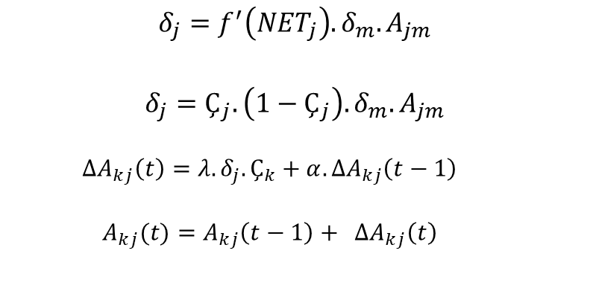
Eğitim Fonksiyonu – Geri Yayılım
$$δ_{j}=f^{′}\left(NET_{j}\right).δ_{m}.A_{jm}$$
$$δ_{j}=Ç_{j}.\left(1−Ç_{j}\right). δ_{m}.A_{jm}$$
$${ΔA}_{kj}\left(t\right)=λ. δ_{j}.Ç_{k}+α. ΔA_{kj}\left(t−1\right)$$
$$A_{kj}(t)={A_{kj}\left(t−1\right)+}_{ } {ΔA}_{kj}\left(t\right)$$
delta_j = Ç_j * (1 - Ç_j) * hidden_error
delta_Akj = np.dot(self.lr * delta_j, np.transpose(inputs))
self.akj += delta_Akj
delta_Bj = self.lr * delta_j
self.bj += delta_Bj

Slide 14
Ağırlıkların Yazdırılması
def print_weight(self):
print("akj:", self.akj)
print("ajm:", self.ajm)
print("bj:", self.bj)
print("bm:", self.bm)

Slide 15
Sinir Ağının Yapılandırma Ayarları
# initialise NN parameters
input_nodes = 784
hidden_nodes = 98
output_nodes = 10
learning_rate = 0.784
# create instance of NN
n = neuralNetwork(input_nodes, hidden_nodes,
output_nodes, learning_rate)

Slide 16
Eğitim Verisinin Alınması
# load the mnist training data CSV file into a list
training_data_file = open("data/mnist_train_100.csv", 'r')
training_data_list = training_data_file.readlines()
training_data_file.close()

Slide 17
Ağın Eğitimine Başlanması
# train the neural network
# epochs is the number of times the training data set is used for training
epochs = 100
for e in range(epochs):
# go through all records in the training data set
for record in training_data_list:
# split the record by the ',' commas
all_values = record.split(',')
# scale and shift the inputs
inputs = (np.asfarray(all_values[1:]) / 255.0 * 0.99) + 0.01
# create the target output values (all 0.01, except the desired label which is 0.99)
B_ç = np.zeros(output_nodes) + 0.01
# all_values[0] is the target label for this record
B_ç[int(all_values[0])] = 0.99
n.train(inputs, B_ç)

Slide 18
Test Verisinin Yüklenmesi
# test NN
test_data_file = open("data/mnist_test_10.csv", 'r')
test_data_list = test_data_file.readlines()
test_data_file.close()
count = 0

Slide 19
for record in test_data_list:
#split the record by the ',' commas
all_values = record.split(',')
# scale and shift the inputs
inputs = (np.asfarray(all_values[1:]) / 255.0 * 0.99) + 0.01
# create the target output values (all 0.01, except the desired label which is 0.99)
B_ç = np.zeros(output_nodes) + 0.01
# all_values[0] is the target label for this record
B_ç[int(all_values[0])] = 0.99
result = n.query(inputs)
print("Ç_m: %d, B_ç: %d " % (np.argmax(result), int(all_values[0])))
if np.argmax(result) == int(all_values[0]):
count += 1
print("Basari: %f" % (count / len(test_data_list)))

Slide 20
Veri Setinin Görselleştirilmesi
#take the data from a record, rearrange it into a 28*28 array and plot it as an image
all_values = test_data_list[0].split(',')
image_array = np.asfarray(all_values[1:]).reshape((28,28))
plt.imshow(image_array, cmap='Greys', interpolation='None')
plt.show()

Slide 21
Doğruluğun Değerlendirilmesi
Deney Numarası | Doğruluk Oranı (%) | Çalışma Süresi (sn)
1
2
3
4
5
Ortalama

Slide 22
Referanslar
[15] Web sitesi: https://www.youtube.com/watch?v=aircAruvnKk, Erişim Tarihi: 10.10.2022
[16] Öztemel, E.; Yapay Sinir Ağları; Papatya Bilim Yayıncılık; İstanbul; 2012
[17] Web sitesi: https://bit.ly/3VdJsW1, Erişim Tarihi: 10.10.2022
[18] Web sitesi: https://www.cs.toronto.edu/~kriz/cifar.html, Erişim Tarihi: 10.10.2022
[19] Web sitesi: https://bit.ly/3CgfPL8, Erişim Tarihi: 10.10.2022
[20] Web sitesi: https://makeavideo.studio/, Erişim Tarihi: 10.10.2022
[21] Web sitesi: https://gtnr.it/3rLFXc3, Erişim Tarihi: 12.10.2022
[22] Web sitesi: https://bit.ly/3s2keN4, Erişim Tarihi: 17.10.2022
[23] Web sitesi: https://www.youtube.com/watch?v=_xkZwJ0H9IU, Erişim Tarihi: 17.10.2022
[24] Web sitesi: https://bit.ly/3MBain4, Erişim Tarihi: 17.10.2022
[25] Web sitesi: https://bit.ly/3S9AuXb, Erişim Tarihi: 17.10.2022
[26] Web sitesi: https://bit.ly/3CDs8l0, Erişim Tarihi: 17.10.2022
[27] Web sitesi: https://cs231n.github.io/neural-networks-1/, Erişim Tarihi: 17.10.2022
[28] Web sitesi: https://en.wikipedia.org/wiki/Neural_network, Erişim Tarihi: 17.10.2022
[29] Kinsley, H., Kukiela, D.; Neural Networks from Scratch in Python.
[30] Rashid, T.; Make Your Own Neural Network.

Slide 23
Referanslar
[31] Web sitesi: https://bit.ly/3D7WDB6, Erişim Tarihi: 18.10.2022
[32] Web sitesi: https://bit.ly/3D6mitS, Erişim Tarihi: 18.10.2022
[33] Web sitesi: https://bit.ly/3yQOaQ1, Erişim Tarihi: 18.10.2022
[34] Web sitesi: https://bit.ly/3VMlQbw, Erişim Tarihi: 18.10.2022
[35] Web sitesi: https://bit.ly/3MCKR4F, Erişim Tarihi: 18.10.2022
[36] Web sitesi: https://bit.ly/3TN6fX7, Erişim Tarihi: 24.10.2022
[37] Web sitesi: https://en.wikipedia.org/wiki/Perceptron, Erişim Tarihi: 24.10.2022
[38] Web sitesi: https://www.nvidia.com/en-us/studio/canvas/, Erişim Tarihi: 25.10.2022
[39] Deep Learning Essentials, W. Di, A. Bhardway, J. Wei, 2018, Packt.
[40] Web sitesi: https://bit.ly/3EHHDcw, Erişim Tarihi: 28.11.2022
[41] Web sitesi: https://bit.ly/3Vtfj4s, Erişim Tarihi: 28.11.2022
[42] Web sitesi: https://intel.ly/3XQGKaz, Erişim Tarihi: 28.11.2022
[43] Web sitesi: https://bit.ly/3GQY8FW, Erişim Tarihi: 29.11.2022
[44] Web sitesi: https://bit.ly/3gXYAYm, Erişim Tarihi: 5.12.2022
[45] Web sitesi: https://bit.ly/3XUpbpP, Erişim Tarihi: 5.12.2022
[46] Jiang, B., Li, B., Zhou, W., Lo, L. Y., Chen, C. K., & Wen, C. Y. (2022). Neural network based model predictive control for a quadrotor UAV. Aerospace, 9(8), 460.

Slide 24
Referanslar
[47] Web sitesi: https://bit.ly/3Pk9fcI, Erişim Tarihi: 13.12.2022
[48] Web sitesi: https://bit.ly/3HtpSkg, Erişim Tarihi: 13.12.2022

Slide 25
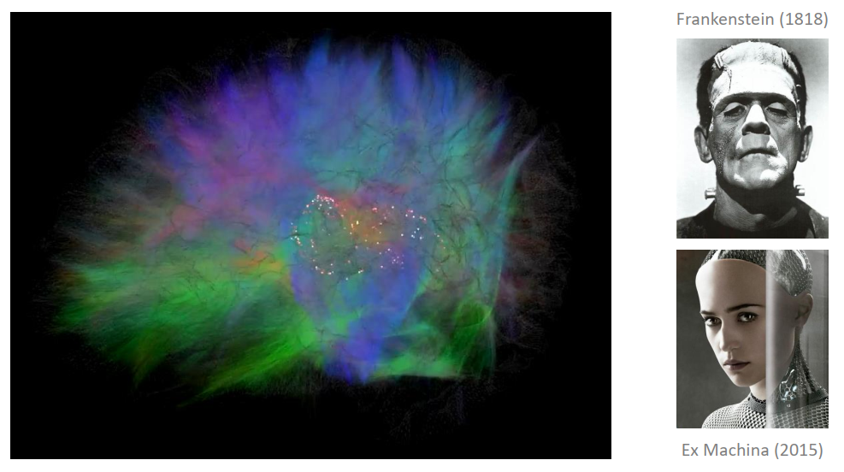
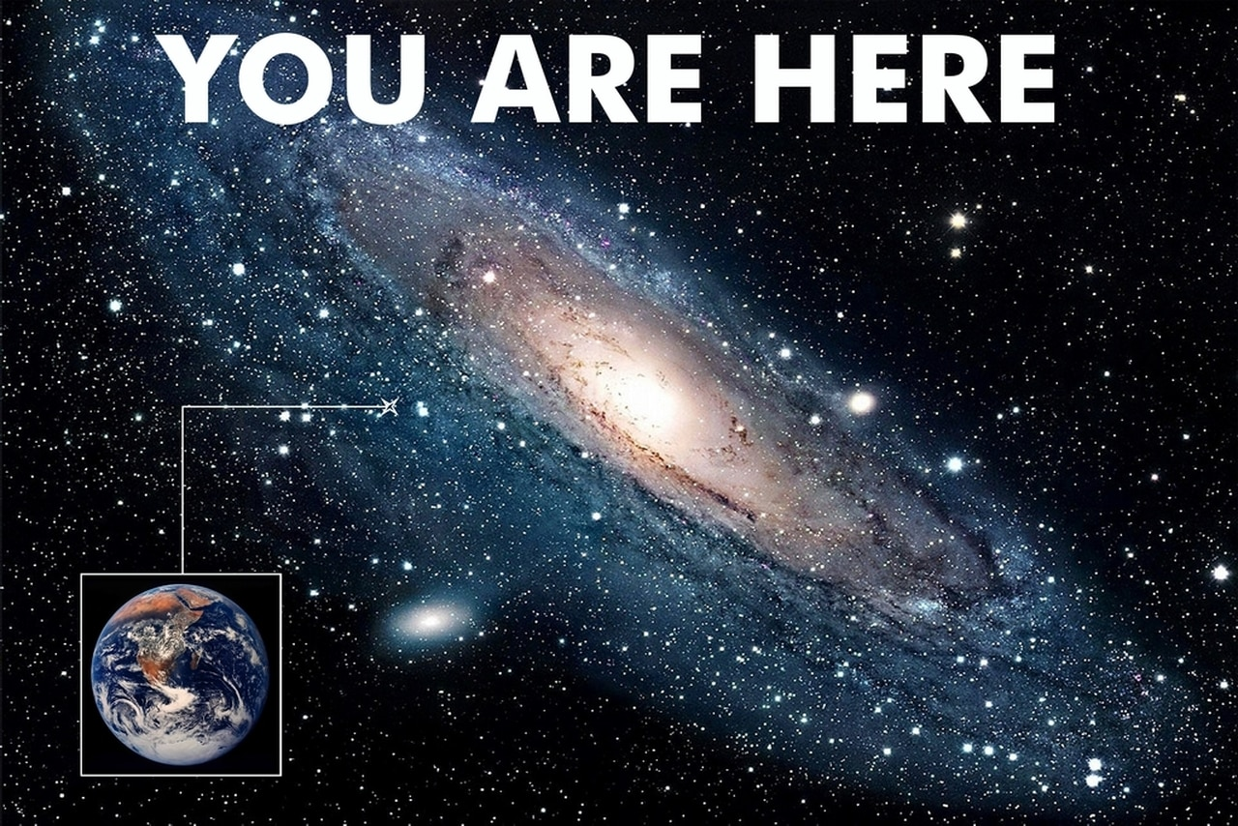
Teşekkürler

